Slide 1
SAMPLING METHOD
MD TAMZID HASAN
B.Sc in EEE (AUST), MPE (CTH),
MPH in Epidemiology (NSU)
Phone: +880 1711 927 924
Email: thunique1988@gmail.com

Slide 2
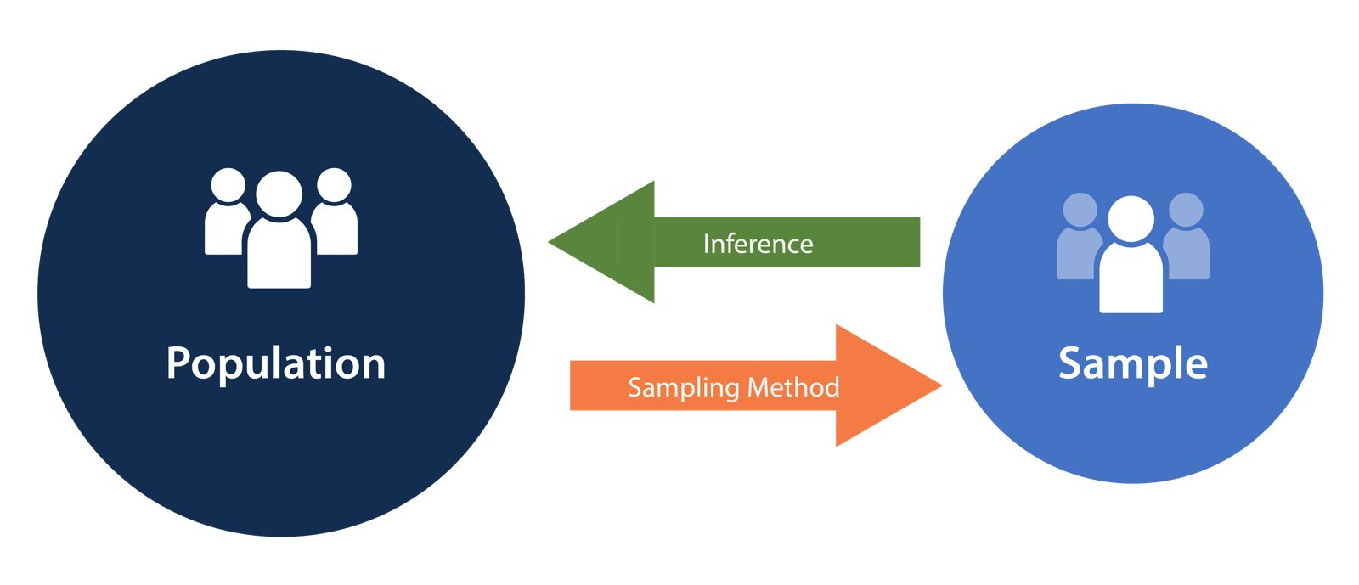
What is Sampling?
Sampling is a technique of selecting individual members or a subset of the population to make statistical inferences from them and estimate the characteristics of the whole population. Different sampling methods are widely used by researchers, so that they do not need to research the entire population to collect actionable insights.
Example: A drug manufacturer would like to research the adverse side effects of a drug on the country’s population. In that case, it is almost impossible to conduct a research study that involves everyone.
MD TAMZID HASAN | thunique1988@gmail.com | +8801711927924

Slide 3
Sampling & Representativeness
Sample
Sampling/Source
Population
Target Population
Target Population ➔ Sampling Population ➔ Sample
MD TAMZID HASAN | thunique1988@gmail.com | +8801711927924

Slide 4
Types of Sampling
Simple Random Sampling
Convenience Sampling
Cluster Sampling
Purposive Sampling
SAMPLING METHOD
Probabiity Sampling
Non-Probability Sampling
Systematic Samplingf
Snowball Sampling
Stratified Random Sampling
Quota Sampling
MD TAMZID HASAN | thunique1988@gmail.com | +8801711927924

Slide 5
Probability Sampling
This is a sampling techniques where a researcher select some criteria to chose participants from the population randomly.
In this technique every participants has equal chance or opportunity in a selection process.
Researcherd choose samples from larger population based on the theory of probability.
Probability sampling eliminates sampling bias in the population.
Example: In a population total 1200 members, so according to probability sampling technique every member will have a 1/1200 chance of being selected to be a part of a sample.
4 types of probability sampling.
MD TAMZID HASAN | thunique1988@gmail.com | +8801711927924

Slide 6
Simple Random Sampling
Equal chance of drawing each unit. And randomly draw the unit.
Advantages: Very simple and sampling error easily measured.
Disadvantages: Need complete list of units or sampling frame, does not always achieve best representative, and units may be scattered.
Example: Evaluate the prevalence of tooth decay among the 1200 children attending a school
List of children attending the school (Sampling frame or list of units)
Children numerated from 1 to 1200
Sample size = 60 children
Random sampling of 60 numbers between 1 and 1200
MD TAMZID HASAN | thunique1988@gmail.com | +8801711927924

Slide 7
Simple Random Sampling
MD TAMZID HASAN | thunique1988@gmail.com | +8801711927924

Slide 8
Systematic Sampling
To choose the member of a population at regular intervals.
It requires selecting a starting point for the sample and sample size determination.
This sampling technique is the less time consuming.
Example: From the previous example
N = 1200, and n = 60
⇒ sampling fraction = 1200/60 = 20
List persons from 1 to 1200
Randomly select a number between 1 and 20 (ex : 8)
⇒ 1st person selected = the 8th on the list
⇒ 2nd person = 8 + 20 = the 28th
etc .....
MD TAMZID HASAN | thunique1988@gmail.com | +8801711927924

Slide 9
Systematic Sampling
1 2 3 4 5 6 7 8 9 10 11 12 13 14 15
16 17 18 19 20 21 22 23 24 25 26 27 28 29 30
31 32 33 34 35 36 37 38 39 40 41 42 43 44 45
46 47 48 49 50 51 52 53 54 55 ……..
MD TAMZID HASAN | thunique1988@gmail.com | +8801711927924

Slide 10
Systematic Random Sampling
1 26 51 76
2 27 52 77
3 28 53 78
4 29 54 79
5 30 55 80
6 31 56 81
7 32 57 82
8 33 58 83
9 34 59 84
10 35 60 85
11 36 61 86
12 37 62 87
13 38 63 88
14 39 64 89
15 40 65 90
16 41 66 91
17 42 67 92
18 43 68 93
19 44 69 94
20 45 70 95
21 46 71 96
22 47 72 97
23 48 73 98
24 49 74 99
25 50 75 100
N = 100
want n = 20
N/n = 5
Select a random number from 1-5: chose 4
Start with #4 and take every 5th unit
MD TAMZID HASAN | thunique1988@gmail.com | +8801711927924

Slide 11
Stratified Random Sampling
The researcher divides the population into smaller groups. And every groups represent the entire population.
Advantages: More precise if variable associated with strata, All subgroups represented, allowing separate conclusions about each of them
Disadvantages: Sampling error difficult to measure, Loss of precision if very small numbers sampled in individual strata
Example: Determination vaccine coverage in a country
One sample drawn in each division
Estimates calculated for each stratum
Each stratum weighted to obtain estimate for country (average)
MD TAMZID HASAN | thunique1988@gmail.com | +8801711927924

Slide 12
Stratified Random Sampling
List of clients
Dhaka
Khulna
Strata
Chittagong
Rajshahi
MD TAMZID HASAN | thunique1988@gmail.com | +8801711927924

Slide 13
Cluster Sampling
The target population is first divided into mutually exclusive and collectively exhaustive subpopulations, or clusters.
Then a random sample of clusters is selected, based on a probability sampling technique such as SRS.
For each selected cluster, either all the elements are included in the sample (one-stage) or a sample of elements is drawn probabilistically (two-stage).
Elements within a cluster should be as heterogeneous as possible, but clusters themselves should be as homogeneous as possible. Ideally, each cluster should be a small-scale representation of the population.
In probability proportionate to size sampling, the clusters are sampled with probability proportional to size.
MD TAMZID HASAN | thunique1988@gmail.com | +8801711927924

Slide 14
Two Stage Cluster Sampling
The population is divided up into subgroups, or “Primary Sampling Units (PSUs)”, that represent aggregates of individual households.
In the first stage, a sample of PSUs is selected.
In the second stage, a sample of individual households is chosen in each of the selected PSUs.
MD TAMZID HASAN | thunique1988@gmail.com | +8801711927924

Slide 15
Multi Stage Cluster Sampling
Consecutive samplings
Example : sampling unit = household
1^{rst} stage : drawing districts
2nd stage : drawing sub-district
3rd stage : drawing households
Stage 1
Stage 2
Stage 3
MD TAMZID HASAN | thunique1988@gmail.com | +8801711927924

Slide 16
Non-Probability Sampling
In non-probability sampling, the researcher randomly chooses members for research.
Sampling method is not fixed or predefined selection process.
Difficult for all population elements to have equal opportunities to have included in a sample.
Some major types of non-probability sampling are disscussed below---
MD TAMZID HASAN | thunique1988@gmail.com | +8801711927924

Slide 17
Convenience Sampling
The sample is identified primarily by convenience.
Example: A professor conducting research might use student volunteers to constitute a sample.
Advantage: Relatively easy, fast, often, but not always, cheap
Disadvantage: It is impossible to determine how representative of the population the sample is.
MD TAMZID HASAN | thunique1988@gmail.com | +8801711927924

Slide 18
Purposive Sampling
Researchers purely consider the purpose of the study, along with the understanding of the target audience.
Participant who want to give the consent, they will select.
MD TAMZID HASAN | thunique1988@gmail.com | +8801711927924

Slide 19
Quota Sampling
Select people nonrandomly according to some quotas
Members in this sampling technique selection happens based on a pre-set standard.
In this case, as a sample is formed based on specific attributes, the created sample will have the same qualities found in the total population. It is a rapid method of collecting samples.
Two types of quota sampling: Proportional quota sampling and non-proportional quota sampling
MD TAMZID HASAN | thunique1988@gmail.com | +8801711927924

Slide 20
Proportional Quota Sampling
Represent major characteristics of population by sampling a proportional amount of each
Example, if you know the population has 40% women and 60% men, you want your sample to meet that quota
Non-proportional Quota Sampling
Making sure you have enough units from each target group of interest (even if not proportional)
MD TAMZID HASAN | thunique1988@gmail.com | +8801711927924

Slide 21
Snowball Sampling
One person recommends another, who recommends another, who recommends another, etc.
Researchers apply when the subjects are difficult to trace.
Good way to identify hard-to-reach populations
For example, adolescents who abuse recreational drugs, Female sex worker, Male sex worker, etc
Researchers also implement this sampling method when the topic is highly sensitive and not openly discussed—for example, surveys to gather information about HIV Aids.
MD TAMZID HASAN | thunique1988@gmail.com | +8801711927924

Slide 22
Heterogeneity Sampling
Make sure you include all sectors - at least several of everything - don't worry about proportions (like in quota sampling)
Use when one or more people are a good proxy for the group
For instance, when brainstorming issues across stakeholder groups
MD TAMZID HASAN | thunique1988@gmail.com | +8801711927924

Slide 23
Respondent Driven Sampling (RDS)
Invented by a sociologist (Heckathorn, 1997)
RDS is a chain referral sampling procedure, similar to Snowball sampling
Sampling probabilities can be calculated
Based on social network theory
It is the only alternative yielding a probability sample when traditional methods do not work
Used for mainly hard to reach populations
MD TAMZID HASAN | thunique1988@gmail.com | +8801711927924

Slide 24
Expert Sampling
Have a panel of experts make a judgment about the representativeness of your sample
Advantage: at least you can say that expert judgment supports the sampling
Problem: the “experts” may be wrong
MD TAMZID HASAN | thunique1988@gmail.com | +8801711927924

Slide 25
Accidental or Haphazard Sampling
“Man on the street”
Student in the library
Available or accessible clients
Volunteer samples
Problem: we have no evidence for representativeness
MD TAMZID HASAN | thunique1988@gmail.com | +8801711927924

Slide 26
THANK YOU
MD TAMZID HASAN | thunique1988@gmail.com | +8801711927924

